Slide 1
Accelerate Mission Impact with AI and Microsoft Cloud for Nonprofit
Nicole Bechard, Senior Technology Advisor, Microsoft

Slide 2
Interaction slide
Nicole Bechard
Senior Technology Advisor
Microsoft Tech for Social Impact

Slide 3
The world is changing
Communities are transforming rapidly
The drivers for impact are evolving
The world is more connected than ever
Notes:
Let’s start with the world today. Things all around us are changing rapidly, and organizations need to adapt. This is nothing new.
If you look back just a few years, we saw that organizations that had already invested in their own digital foundation were able to weather the disruption of the pandemic better than their peers, with many of them emerging even stronger than before.
We believe we're on the cusp of a similar inflection point today.
The pressures today are different – the global workforce is shrinking and security threats emerge and evolve faster than ever.
But the pace of change hasn’t slowed.

Slide 4
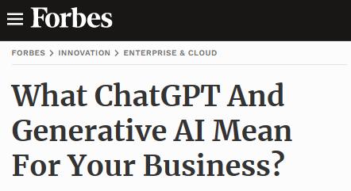
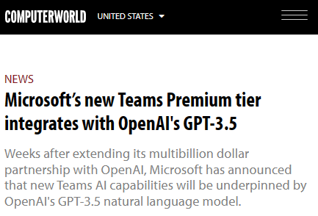
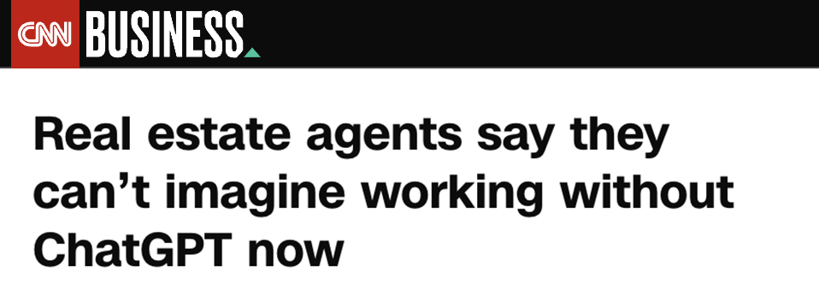
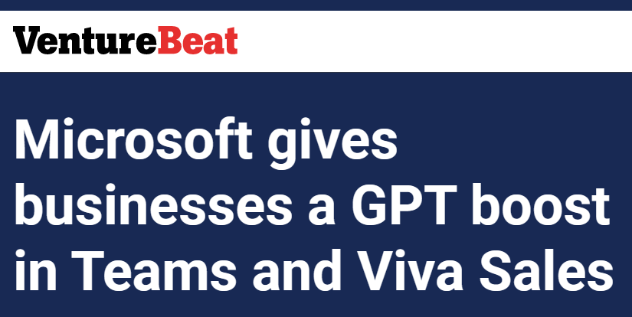
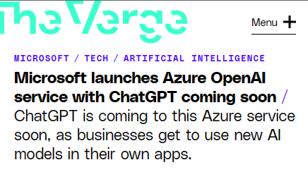
The AI technology is here
Notes:
Technology is advancing quickly, grabbing headlines every day.
Experiences based on large language models, like ChatGPT, have taken the world by storm, in part because they can draw a vast store of data leveraging the massive computing power available today in the cloud.

Slide 5
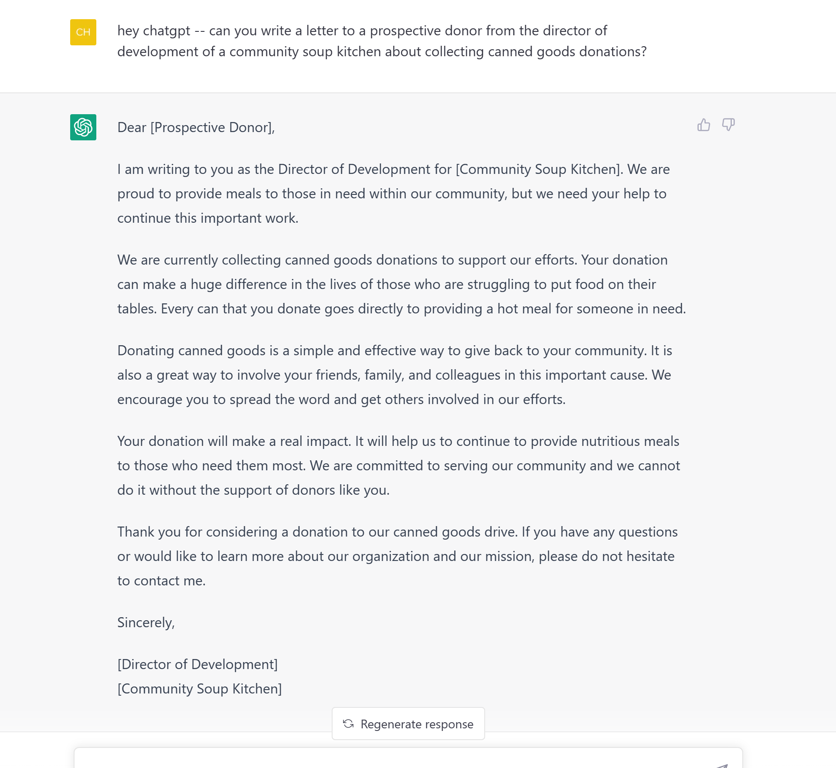
It’s already at work…
Notes:
We’ve seen this technology break through with people around the world – it’s not just for tech workers anymore.
As a result, you can expect your staff to start demanding these kinds of experiences in the tools they use each day. Similarly, your constituents will quickly come to expect AI capabilities in the services you offer, if they don’t already.
But there’s an exciting third element – and that’s the real, tangible impact technology like this can drive.

Slide 6
Empower every nonprofit and international development organization with Microsoft technology to accelerate social impact
Notes:
We are called upon to empower the world’s organizations to lead the AI transformation for a new era – and we have the track record to help you do it.
The Tech for Social Impact team is truly committed to this sector and to the idea that it is absolutely core to Microsoft’s mission to empower every nonprofit and international development organization with Microsoft technology to accelerate social impact.

Slide 7
Microsoft is fueling AI innovation
Decades of research & development
Committed to advancing Responsible AI
Secure from the start
Reliability & performance at scale for large AI models
Trusted by AI leaders like OpenAI
Notes:
So, how are we doing this?
We have invested in fueling AI innovation for years.
We’ve spent decades in research and development.
We’re committed to advancing the principles and practice of Responsible AI.
We’ve built security and trust into our platform and all our solutions right from the start.
We’ve created purpose-built AI infrastructure to deliver reliability and performance at scale, based on thousands of interconnected GPUs and Infiniband networking.
And as a result, we are trusted by AI leaders like OpenAI and many others. In fact, OpenAI builds and trains all of their AI models and experiences using the unique AI infrastructure of Microsoft Azure.
This innovation is exciting, and I am thrilled to share more with you over the course of this talk.
But as AI is poised to transform our lives, we must collectively define new rules, norms, and practices for the use and impact of this technology.

Slide 8
Microsoft’s Responsible AI principles
Privacy & Security
Building blocks to enact principles
Reliability & Safety
Inclusiveness
Tools and processes
Microsoft’s Responsible AI Principles
Training and practices
Rules
Fairness
Accountability
Governance
Transparency
Notes:
That’s why we began our Responsible AI journey back in 2017.
We believe that the development and deployment of AI must be guided by the creation of an ethical framework. In 2018, we set out our view that there are six core principles that should guide the work around AI.
But it’s not enough to define these principles – we need to operationalize them at scale as well.
We’re focused on four key areas to help put these principles into action:
First, you need governance.
Second, you need the rules to standardize AI requirements.
Third, you need training and best practices.
And fourth, you need the tools for implementation.
We’ll talk more about some of this tooling later on, but for now let’s ask the question:
How can you get started?

Slide 9
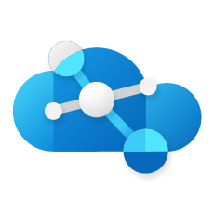
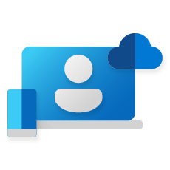
Microsoft Cloud
Microsoft Cloud for Nonprofit
c
b
a
Infrastructure
Comprehensive
Trusted
Security
Digital and app innovation
Microsoft Cloud
Build capacity with AI - while staying human to meet your organization's growing needs.
Business applications
Data and AI
Deepen your community impact with intelligent apps using AI
Modern work
Notes:
That’s where we come back to Microsoft’s mission, and what we’ve built with the Microsoft Cloud.
The Microsoft Cloud is unique in both the breadth and the depth of the cloud solutions we provide.
You can use each of our cloud solutions on a standalone basis or take advantage of the seamless way we’ve integrated and architected them to work well together.
And with the Microsoft Cloud, we can enable you to use AI to drive transformation within your organizations.
We are doing this in two ways:
First, we’ll help you radically accelerate staff capacity by leveraging transformational AI built into every Microsoft Cloud solution.
And second, we are delivering the tools and services you need to build your own intelligent apps and services using Azure AI.

Slide 10
Microsoft Cloud
Microsoft Cloud for Nonprofit
c
b
a
Infrastructure
Comprehensive
Trusted
Digital and app innovation
Security
Digital and app innovation
Business applications
Data and AI
Modern work
Notes:
Let’s start with how we’re bringing AI capabilities to life to power digital & application innovation.

Slide 11
One integrated developer platform
GitHub Enterprise
Redefine collaboration
Automate entire workflows
Secure DevSecOps
Loved by 100M+ developers
Used by >90% of Fortune 100
Notes:
We are living in a world where every organization is becoming a technology company, and looking to be able to develop apps and solutions to power their business.
GitHub Enterprise provides developers with an integrated developer platform that they can use to collaborate, automate and secure their DevOps solutions.
GitHub is used and loved by more than 100 million developers around the world today.
And it is now trusted by more than 90% of the Fortune 100 companies in the world to run their businesses – and is accessible to nonprofit organizations across the globe.

Slide 12
GitHub Copilot
“This is the single most mind-blowing application of machine learning I’ve ever seen.”
Mike Krieger, Co-founder, Instagram
Notes:
One of the most exciting new capabilities we’ve recently launched with GitHub is a new service we call GitHub Copilot.
Copilot was the first solution built using the new transformational large AI models developed by OpenAI.
Copilot provides an AI-pair programmer that works with all of the popular programming languages, and that dramatically accelerates developer productivity.
Developers using Github Copilot see a 55% productivity boost when working on real-world projects and tasks.
Let’s take a look at GitHub Copilot in action…

Slide 13
GitHub Copilot Demo
VIDEO 1
GitHub Copilot Demo
Notes:
[NOTE FOR SPEAKER: PRESS PLAY ON VIDEO]

Slide 14
GitHub copilot detail
46%
of new code is now written by AI
55%
faster overall developer productivity
75%
developers feel more focused on satisfying work
Notes:
That video showed you a brief look at how Copilot transforms developers’ creation of code.
In fact, up to 40% of all lines of code written by developers using Copilot are now fully AI generated.
In measured tests conducted by 3rd parties, they’ve found that developers using Copilot are 55% more productive in completing tasks and applications.
But even more striking to me is what developers think about the Copilot experience – they love it. 74% of developers using Copilot report feeling that they can now focus on more satisfying work and enjoy their jobs more.
Debugging and looking up regular expressions is not satisfying. By having that work autogenerated, developers can instead focus on things that make them feel more satisfied, complete their work faster, and feel more productive. This is really transformational in terms of how development teams work.
Copilot for Business is generally available now for all developers to use today with all developer languages on all platforms and with all types of developer tools.

Slide 15
Microsoft Cloud
Microsoft Cloud for Nonprofit
c
b
a
Infrastructure
Comprehensive
Trusted
Security
Digital and app innovation
Business applications
Business applications
Data and AI
Modern work
Notes:
Now let’s talk about business applications.

Slide 16
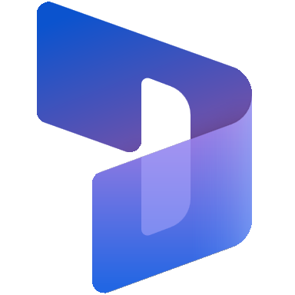
Connect your impact, break through with personalization, and engage with constuents everywhere, anytime
Dynamics 365
Power Platform
Viva Sales*
Create impact faster
Break through barriers
Adapt to anything
Innovate everywhere
*Coming soon to Fundraising and Engagement!
Notes:
Every organization is looking to deepen mission impact, reduce costs, and create a hyperconnected community.
Dynamics 365, Power Platform, and solutions like Viva Sales enable you to do just that.
With Microsoft’s business applications solutions, you can create impact faster, break through the barriers that silo your data, adapt and be more agile, and innovate everywhere across your organization.
Across the Business Applications portfolio, we are leveraging AI capabilities to make it easier to drive meaningful community experiences.
Today I want to highlight some particularly innovative AI capabilities we are adding to Viva Sales.

Slide 17
Viva Sales
Viva Sales
Cut the forms
Connect the data
Stay connected
AI-driven conversational intelligence, real-time coaching, relationship insights
Integrated selling within Microsoft 365
Supports both Dynamics 365 and Salesforce
Notes:
Viva Sales – which is coming soon to Fundraising and Engagement in Microsoft Cloud for Nonprofit – is designed to help fundraisers reduce unnecessary form input, connect data they need to do their job efficiently, and ultimately be more proactive with their donor community.
Viva Sales now gives fundraisers the AI capabilities that enable personalized coaching and intelligence – meaning that funders can develop a greater understanding of their donors. And, ultimately, this can translate to larger, more impactful donations.
It delivers a seamless experience built into the apps your team is already using, including Microsoft Teams and Outlook.
And it works and connects directly to your CRM system – whether it’s Dynamics 365 or Salesforce.

Slide 18
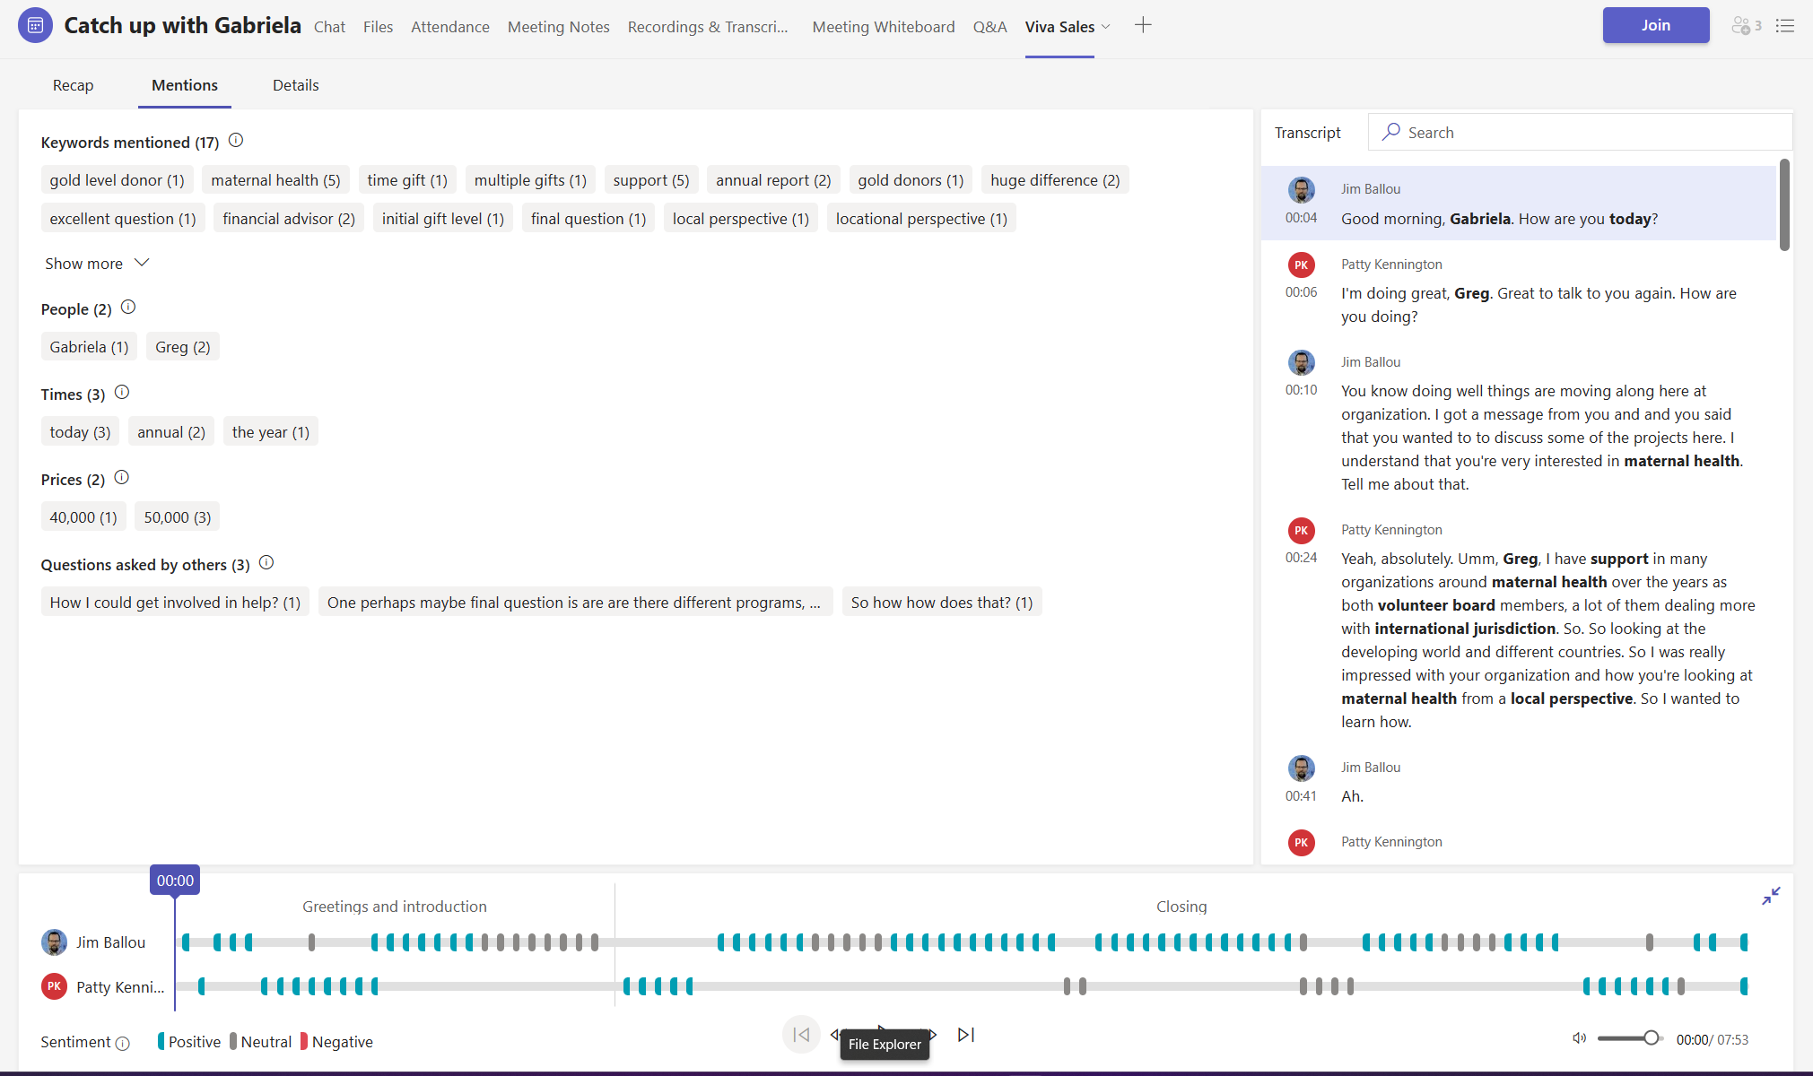
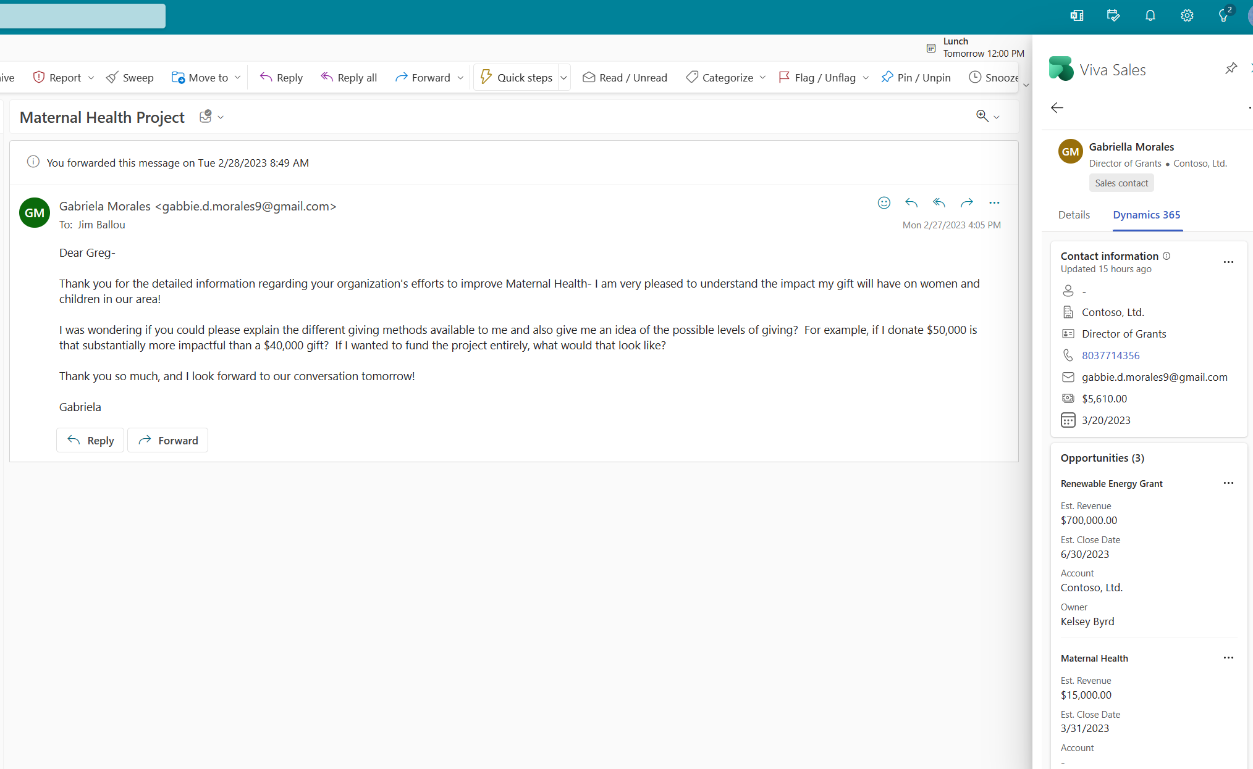
Viva Sales
Notes:
Just like you saw earlier with GitHub Copilot, we are using the large transformational AI models we are building with OpenAI to dramatically improve text understanding and content creation…all working inside Outlook – and automatically working with data in the CRM.
Everything you saw in that video is available to use with both Dynamics 365 and Salesforce based CRM systems today.

Slide 19
The world’s first AI Copilot in both CRM and ERP
Fundraising
Marketing
Service
Supply Chain
Operations
Recap meetings
Craft donor emails
Generate content ideas
Create audience segments
Simply constituent insights
Create constituent responses
Enhance self-service bots
Predict disruptions
Create product descriptions
Dynamics 365 Copilot
Notes:
And, there’s more! As you may have heard on March 15, just as Github Copilot transforms how developers create code, Dynamics 365 Copilot will transform business processes across the organization.
Microsoft Dynamics 365 Copilot provides interactive, AI-powered assistance across business functions—from fundraising, marketing, service, supply chain, and operations. With Dynamics 365 Copilot, we’re introducing the world’s first AI copilot natively built-in to both CRM and ERP applications.

Slide 20
Microsoft Cloud
Microsoft Cloud for Nonprofit
c
b
a
Infrastructure
Comprehensive
Trusted
Security
Digital and app innovation
Microsoft Cloud
Build capacity with AI - while staying human to meet your organization's growing needs.
Business applications
Data and AI
Deepen your community impact with intelligent apps using AI
Modern work
Notes:
Now, let's focus on how you can build transformational experiences into your own apps and services using Azure AI.

Slide 21
In the age of AI, every app should be intelligent
Apps
Data
AI Models
Notes:
In the age of AI, intelligent app experiences become competitive differentiators. Increasingly, organizations are turning to cloud-native technologies and AI/ML to develop their mission-critical applications.
These modern technologies and models provide organizations with the security, agility and velocity required to scale and transform.
Leveraging cloud apps + data + AI services is how every organization can stand out from the competition with intelligent apps built with AI.

Slide 22
Azure AI
Azure Machine Learning
Cognitive Services
Azure AI Infrastructure
Azure OpenAI Service
Notes:
When we talk about Azure AI, it includes four core categories of AI capabilities, all informed by decades of Microsoft’s research and development in this space.
Azure Machine Learning, Cognitive Services, Azure AI Infrastructure, and our new Azure OpenAI Service – which became generally available in January.
With Azure's cloud application platform, you can run intelligent cloud-native apps with Azure Kubernetes Service or gain the productivity and rapid time to market benefits of platform-as-a-service with App Service.
Apps running on AKS or App Service can easily and natively embed Azure AI services.

Slide 25
Microsoft Cloud
Microsoft Cloud for Nonprofit
c
b
a
Infrastructure
Comprehensive
Trusted
Security
Digital and app innovation
Microsoft Cloud
Build capacity with AI - while staying human to meet your organization's growing needs.
Business applications
Data and AI
Deepen your community impact with intelligent apps using AI
Modern work
Notes:
That’s where we come back to Microsoft’s mission, and what we’ve built with the Microsoft Cloud.
Again, you can use each of our cloud solutions on a standalone basis or take advantage of the seamless way we’ve integrated and architected them to work well together.
And with the Microsoft Cloud, we can enable you to use AI to drive transformation within your organization.

Slide 26
Practical Nonprofit AI Use Cases
ChatGPT for recommended marketing and fundraising content
ML/AI for donor propensity and engagement forecasting
Predictive templates in knowledge work for operations and finance
Analysis and futurecasting for response-ready community programs
Notes:
Here are just a few ways that nonprofits can take advantage of AI today:
Chat GPT for recommended marketing and fundraising content
ML/AU for donor propensity and engagement forecasting
Predictive templates in knowledge work for operations and finance
Analysis and future-casting for response-ready community programs

Slide 27
How do I get started?
Get your data estate AI-ready with Azure
Build intelligent app experiences with Azure AI
Increase developer productivity with GitHub
Increase fundraising productivity with Viva Sales
Learn how migrating your data to Azure can give you the foundation for better AI experiences
Learn how to build AI-powered applications for your organization on Azure
Learn how GitHub Copilot can drive 55% greater productivity with developers
Learn how AI capabilities enable personalized coaching and
intelligence for fundraisers
Leverage AMMP to conduct a data estate assessment
Book an AI executive briefing session
Try GitHub Copilot today
Try Viva Sales today
microsoft.com/nonprofits
Notes:
So hopefully by this point you’re asking yourself “Great! How do I get started?”
Let’s walk through a few suggestions as potential starting points.
Getting AI-ready means you’ve invested time to evaluate your data estate and are making the necessary moves to migrate your data to Azure. You can set up a briefing on the Microsoft Intelligent Data Platform and conduct a data estate assessment.
With your data estate well managed, you’ll want to explore intelligent app experiences with Azure AI. An AI workshop to identify use cases can help you unlock competitive differentiation through your data.
Now, we know developing applications can be time consuming, but with GitHub Copilot you can significantly increase developer productivity. Customers using Github Copilot are reporting that their developers are 55% faster – and who doesn’t need more development resources today?
Lastly, Viva Sales is an impactful tool to increase fundraiser productivity, harnessing the power of generative AI to automatically create rich, customer relevant content right inside the Microsoft 365 apps your team already uses every day.
This is just the beginning of what the age of AI holds in store for us as we continue to pursue our vision to empower every person and every organization on the planet to achieve more.
We’re so excited, and hope you are too!

Slide 28
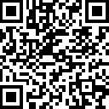
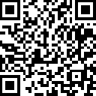
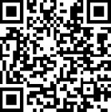
Next Steps
1
2
3
Read how nonprofits are driving impact with Microsoft Cloud for Nonprofit aka.ms/TSIStories
Sign up to stay informed: aka.ms/AFPIcon2023
Get started with offers from TSI: aka.ms/TSIOffers

